Slide 1
Deep Networks - VGGNet, GoogLeNet
Pattern Recognition & Machine Learning Laboratory
Ji-Sang Hwang, Aug 3, 2021

Slide 2
VGGNet & GoogLeNet
Introduction
Improvement in object classification and detection capabilities with deep learning and convolutional networks (ConvNets)
Progress is a consequence of new ideas, algorithms and improved network architectures
Discussion
Receptive smaller window size and smaller stride of the first convolutional layer [Zeiler & Fergus, 2013; Sermanet et al., 2014]
Training and testing networks densely over the whole image and over multiple scales [Sermanet et al., 2014; Howard, 2014]
These papers,
Address another important aspect of
ConvNet architecture design
Deep / Depth
Increased network depth
A new level of organization in the
form of the “Inception module”
Meme of the Inception
Zeiler, M. D. and Fergus, R. “Visualizing and understanding convolutional networks”, ECCV, 2014.
Sermanet, P., Eigen, D., Zhang, X., Mathieu, M., Fergus, R., and LeCun, Y. “OverFeat: Integrated Recognition,
Localization and Detection using Convolutional Networks”, ICLR, 2014.

Slide 3
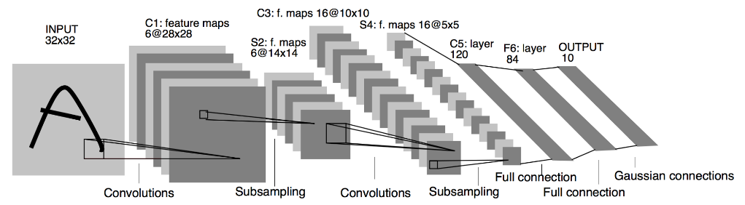
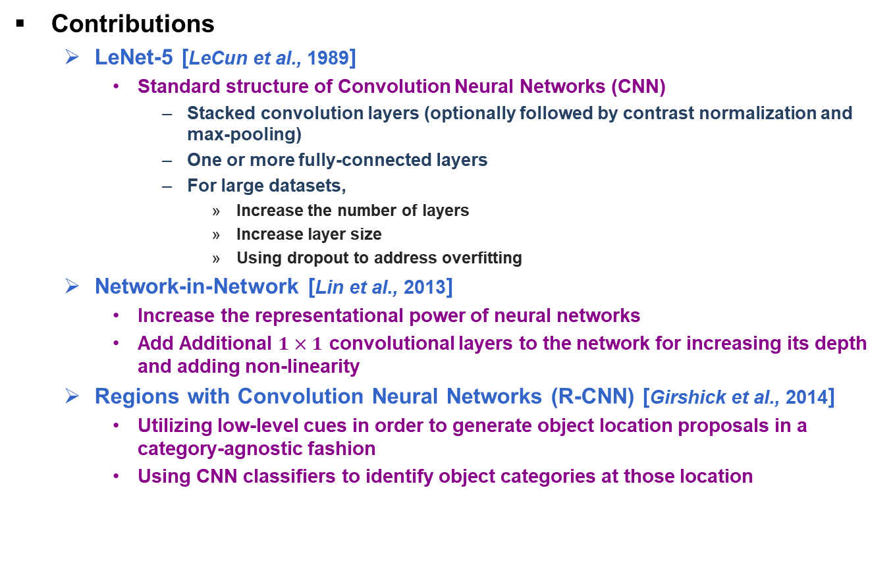
Related Work
Contributions
LeNet-5 [LeCun et al., 1989]
Standard structure of Convolution Neural Networks (CNN)
Stacked convolution layers (optionally followed by contrast normalization and max-pooling)
One or more fully-connected layers
For large datasets,
Increase the number of layers
Increase layer size
Using dropout to address overfitting
Network-in-Network [Lin et al., 2013]
Increase the representational power of neural networks
Add Additional $1×1$ convolutional layers to the network for increasing its depth and adding non-linearity
Regions with Convolution Neural Networks (R-CNN) [Girshick et al., 2014]
Utilizing low-level cues in order to generate object location proposals in a category-agnostic fashion
Using CNN classifiers to identify object categories at those location
Architectures of LeNet-5
LeCun, Y., Boser, B., Denker, J. S., Henderson, D., Howard, R. E., Hubbard, W., and Jackel, L. D. “Backpropagation applied to handwritten zip code recognition”, Neural Computation, 1989.
M. Lin, Q. Chen, and S. Yan. “Network in network”, CoRR, 2013.
R. B. Girshick, J. Donahue, T. Darrell, and J. Malik. “Rich feature hierarchies for accurate object detection and semantic segmentation”, Computer Vision and Pattern Recognition, 2014. CVPR 2014. IEEE Conference on, 2014.

Slide 4

Very Deep Convolutional Networks for Large-Scale Image Recognition [K. Simonyan et al.] (1/2)
Softmax
FC
Architecture of VGGNet
Use $3×3$ convolution filter (smallest size to capture the notion of left/right, up/down, center)
Reason of using $3×3$ convolution filter
3 non-linear rectification layers make the decision function more discriminative
Decrease the number of parameters
3-layer $3×3$ convolution stack : $3×\left(3×3×C×C\right)=27C^{2}$, $C$ : Channel
1-layer $7×7$ convolution stack : $\left(7×7×C×C\right)=49C^{2}$
A stack of convolutional layers is followed by 3 Fully-Connected layers
Hidden layers are equipped with rectification (Rectified Linear Unit (ReLU))
FC
FC
Pool
Conv
Conv
Pool
Conv
Conv
Pool
Conv
Conv
Convolution (Conv)
Pooling (Pool)
SoftMax
Fully-connected Layer (FC)
Pool
FC
FC
FC
Input
Softmax
Conv
Conv
Pool
Conv
Pool
Conv
Architectures of VGGNet-13 (Top) and AlexNet (Bottom)
Conv
Pool
Conv
Conv
Input

Slide 5
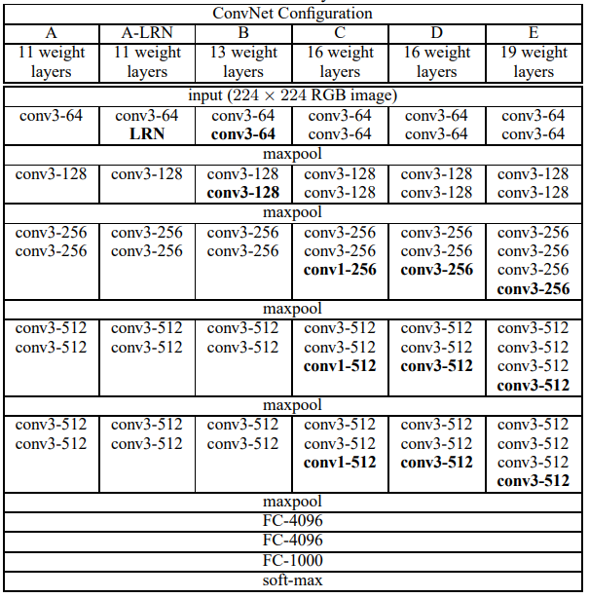

Very Deep Convolutional Networks for Large-Scale Image Recognition [K. Simonyan et al.] (2/2)
Differ only in the depth
From 11 weight layers in the network A to 19 weight layers in the network E
Using Local response normalization (LRN) does not improve on the model a without any normalization layer
$1×1$ convolution filter is a way to
increase the non-linearity of decision
function without affecting the receptive
fields of the convolutional layers
Using pre-initialized layers to prohibit
stalling learning due to instability of
gradient in deep nets
Initialized first 4 convolutional layers
and the last 3 fully-connected layers
of network A
Did not decrease the learning rate for
pre-initialized layers when training
another networks
Table of ConvNet configurations
Table of number of parmaters (in millions)
Network | A, A-LRN | B | C | D | E
Number of parameters | 133M | 133M | 134M | 138M | 144M

Slide 6
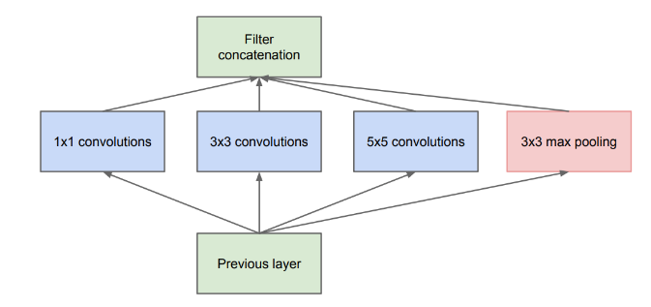
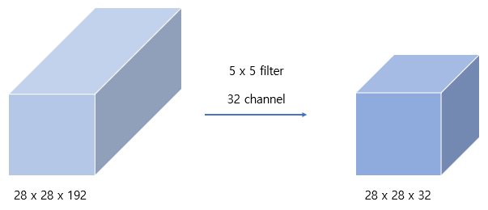
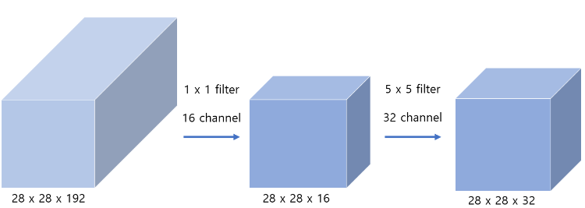
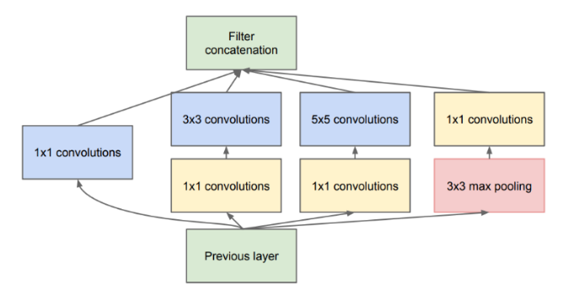



Going Deeper with Convolutions [C. Szegedy et al.] (1/2)
Method
Architecture of The Inception
Consider how an optimal local sparse structure of a convolutional network can be approximated and covered by readily available dense components
Problems of Naïve Version
A modest number of $5×5$ convolutions can be prohibitively expensive
Leading to a computational blow up within a few stage
Solving problems with $1×1$ convolutional layer
Using $1×1$ ‘bottleneck’ layers to compute reductions
before the expensive $3×3$ and $5×5$ convolutions
Including the use of rectified linear activation
for adding non-linearity
Image of inception module(Naïve Version)
5x5 convolution
5x5 convolution with 1x1 convolution
$$28×28×32×5×5×192$$
$$=120.4M$$
$$(28×28×16×1×1×192)+(28×28×32×5×5×16)$$
$$=12.4M$$
Image of inception module(Dimension reduction)
Howard, A. G. “Some improvements on deep convolutional neural network based image classification”, ICLR, 2014.

Slide 7
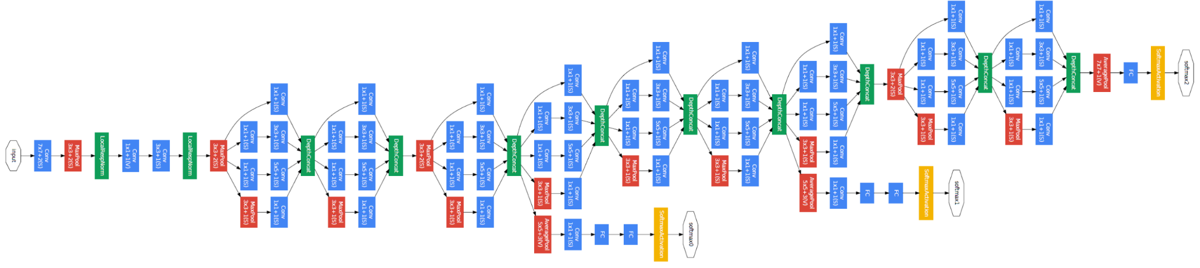

Going Deeper with Convolutions [C. Szegedy et al.] (2/2)
Architecture of GoogLeNet
22 layers deep when counting only layers with parameters
The use of ‘average pooling’ before the classifier enables to easily adapt networks to other label sets
Adding ‘auxiliary classifiers’ to combat the vanishing gradient problems while providing regularization
An average pooling layer with $5×5$ filter size and stride 3
A $1×1$ convolution with 128 filters for dimension reduction and rectified linear activation
A fully connected layer with 1024 units and rectified linear activation
A linear layer with softmax loss as the classifier
Convolution
Pooling
SoftMax
Concat/Normalize
□ Inception layer
□ Average pooling
□ Auxiliary classifiers
GoogLeNet architecture

Slide 8
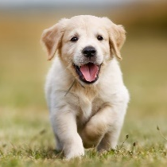
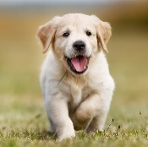

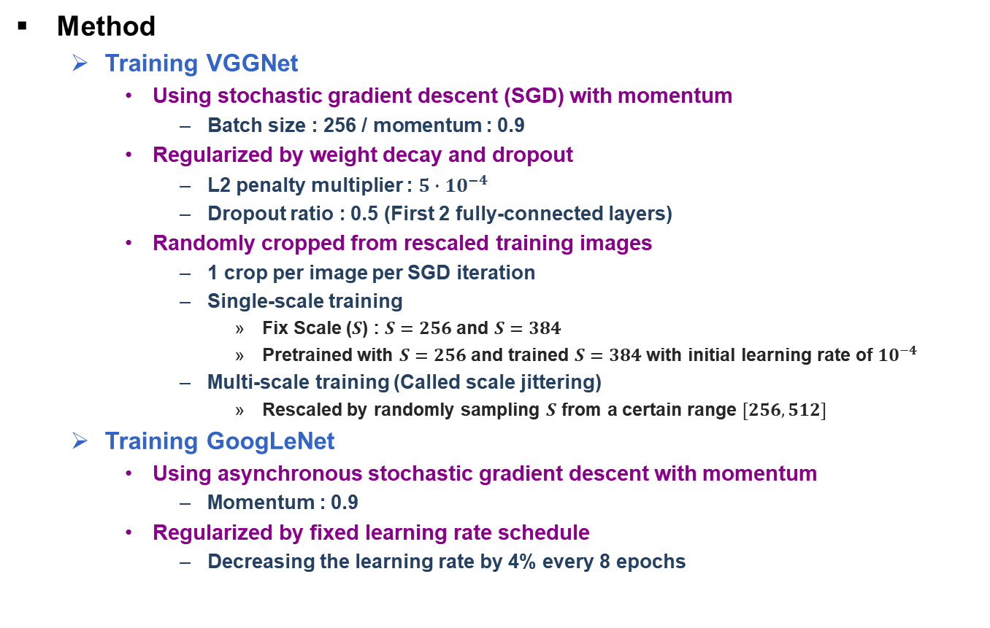
Training Models
Method
Training VGGNet
Using stochastic gradient descent (SGD) with momentum
Batch size : 256 / momentum : 0.9
Regularized by weight decay and dropout
L2 penalty multiplier : $5∙{10}^{−4}$
Dropout ratio : 0.5 (First 2 fully-connected layers)
Randomly cropped from rescaled training images
1 crop per image per SGD iteration
Single-scale training
Fix Scale ($S$) : $S=256$ and $S=384$
Pretrained with $S=256$ and trained $S=384$ with initial learning rate of ${10}^{−4}$
Multi-scale training (Called scale jittering)
Rescaled by randomly sampling $S$ from a certain range $[256, 512]$
Training GoogLeNet
Using asynchronous stochastic gradient descent with momentum
Momentum : 0.9
Regularized by fixed learning rate schedule
Decreasing the learning rate by 4% every 8 epochs
NxN
256x256
512x512
Example of Multi-scale training

Slide 9
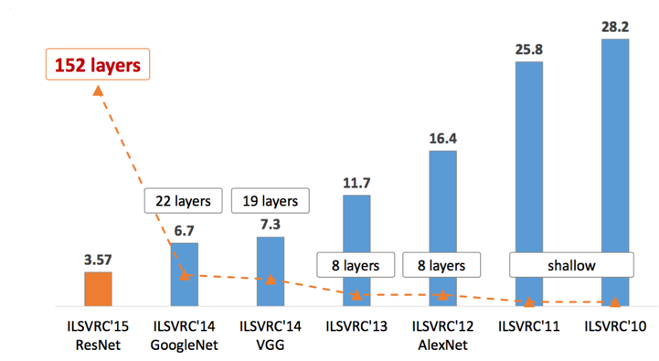
Conclusion
Result
ImageNet Large Scale Visual Recognition Challenge (ILSVRC) 2014 Classification Challenge Result
Setup of GoogLeNet
Trained independently 7 versions of same GoogLeNet model and performed ensemble prediction with them
Aggressive cropping approach during testing (Resize 256, 288, 320, 352)
The softmax probabilities are averaged over multiple crops and all individual classifiers to obtain the final prediction
Conclusion
GoogLeNet
Significant quality gain at a modest increase
of computational requirements to shallower
and narrower architectures
VGGNet
Importance of dept in visual representations
Table of classification performance in ILSVRC 2014
Team | Year | Place | Error (top-5) | Uses external data | Layers | Parms
GoogLeNet | 2014 | 1st | 6.67% | No | 22 layers | 5 M
VGG | 2014 | 2nd | 7.32% | No | 19 layers | 144 M
Result of classification performance in ILSVRC

